Slide 1
Descriptive Analytics Exercise
June 4, 2021

Slide 2
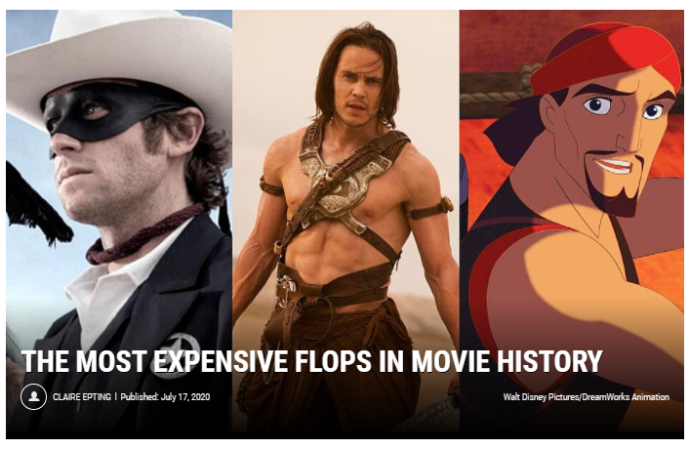
Use Case: How to not flop an expensive movie?

Slide 3
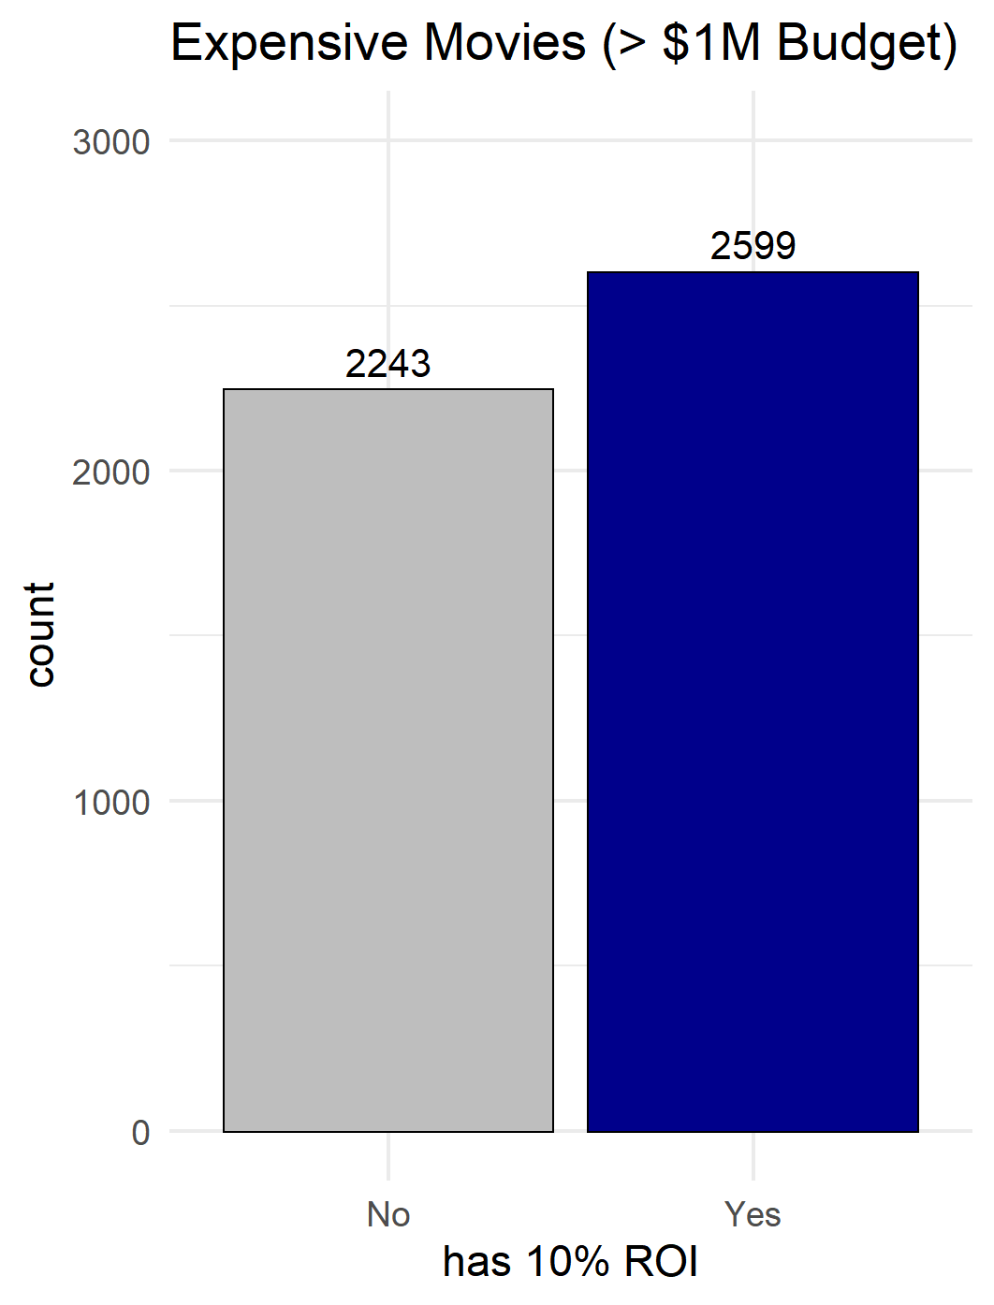
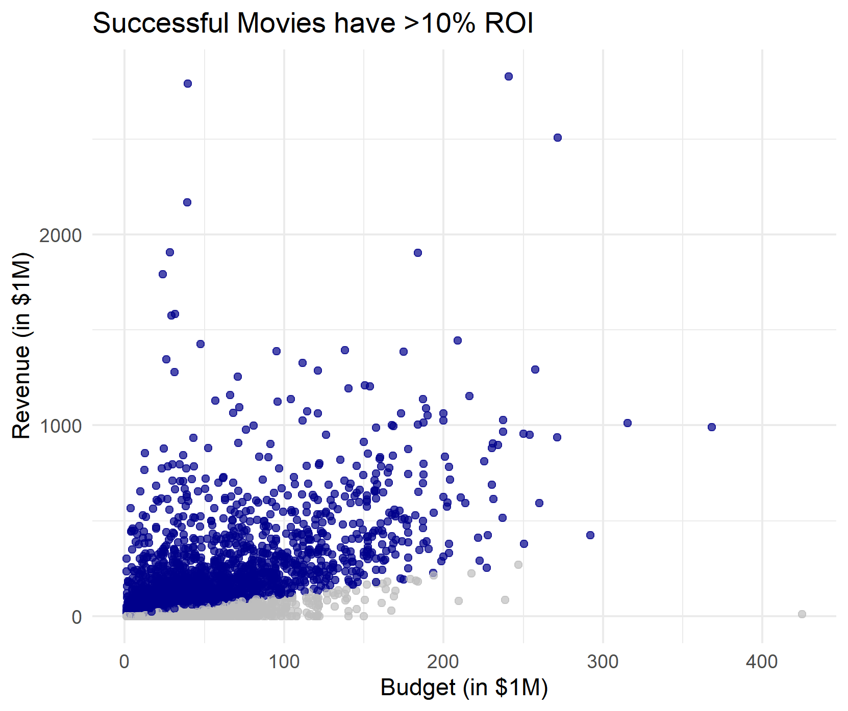
Use Case: How to not flop an expensive movie?
Problem: Expensive movies give no assurance that the movie will always be profitable.
Source: IMDB 10k Movies Dataset | Note: budget and revenue were adjusted according to the inflation
CONFIDENTIAL © 2020 MDI NOVARE, Inc. All rights reserved.
Notes:
Goal: profiling their customers as to show signs of improvement understanding on the customers paying conduct
To analyse the patterns of paying behavior of the customers
To identify the features or variables of customers on paying electricity
To determine the most suitable data mining model based on identified variables

Slide 4
Use Case: How to not flop an expensive movie?
Problem: What makes a successful expensive movies?
Compare Profitable Movies on the following characteristics:
Popularity Score
Movie Runtimes
Vote Count
Vote Average
Release Year
Release Month
Genre
CONFIDENTIAL © 2020 MDI NOVARE, Inc. All rights reserved.
Notes:
Goal: profiling their customers as to show signs of improvement understanding on the customers paying conduct
To analyse the patterns of paying behavior of the customers
To identify the features or variables of customers on paying electricity
To determine the most suitable data mining model based on identified variables

Slide 5
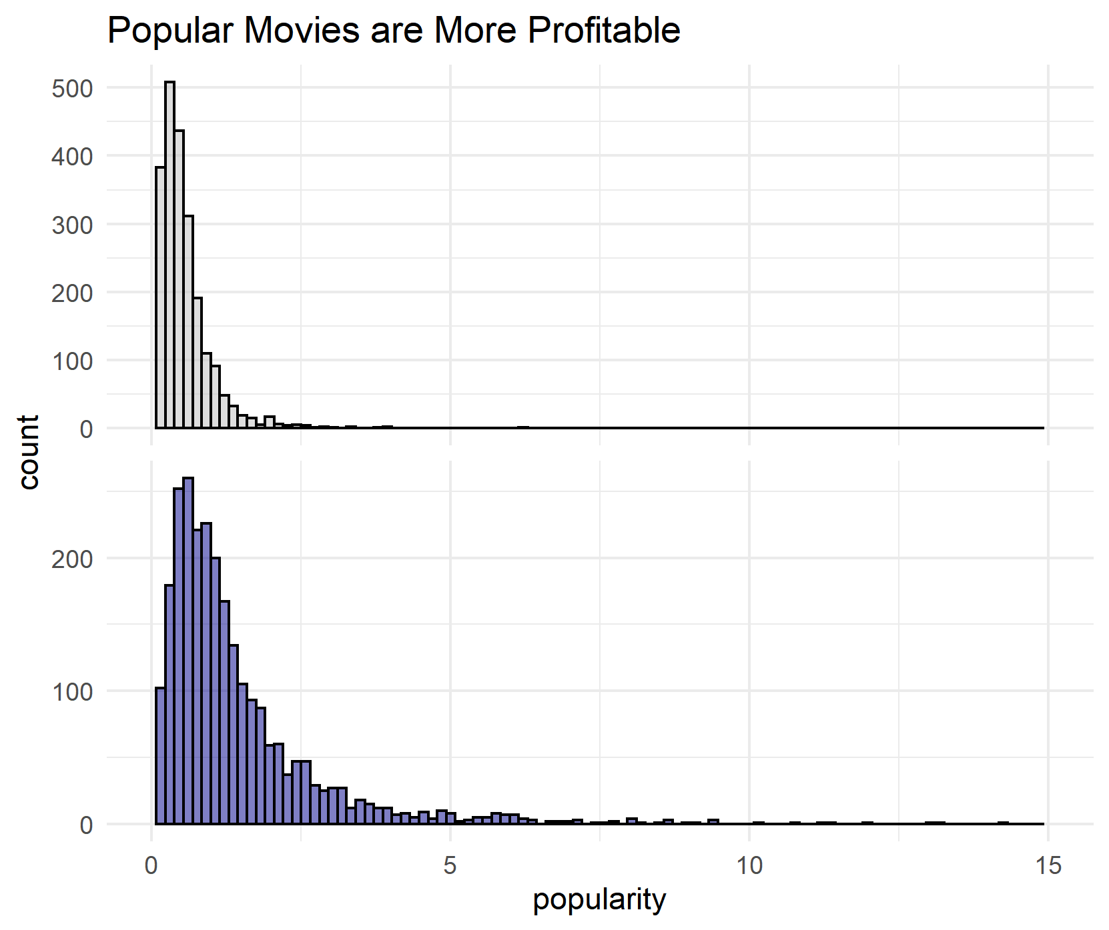
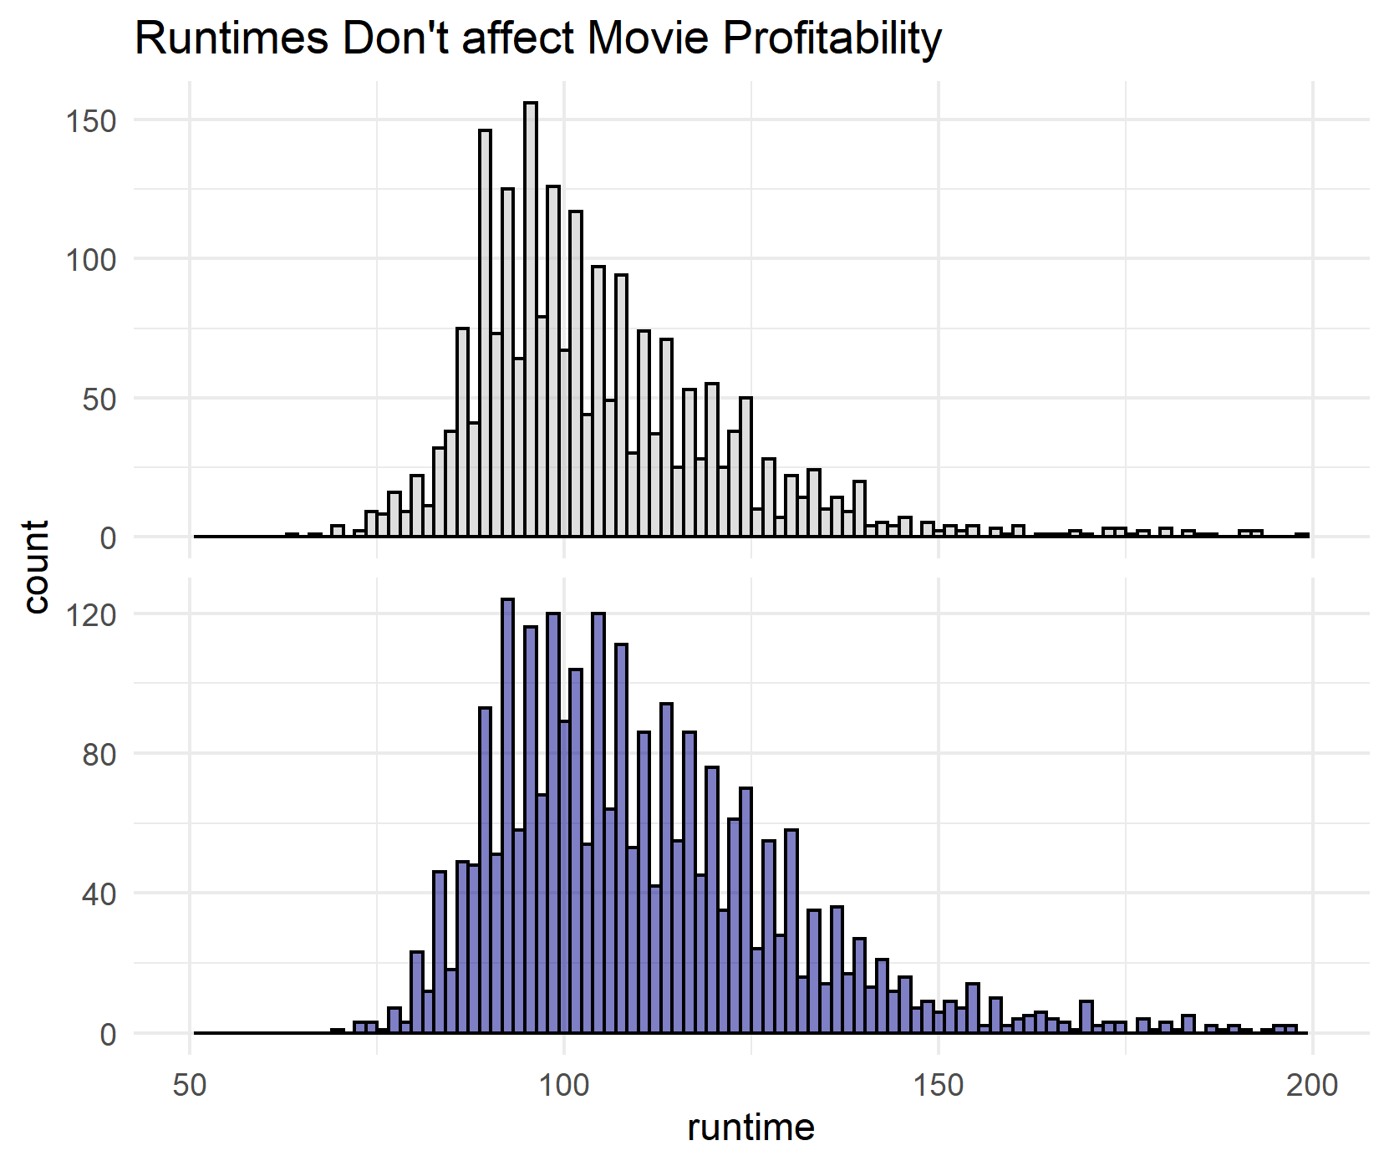
Use Case: How to not flop an expensive movie?
Flopped Movies versus Successful Movies
CONFIDENTIAL © 2020 MDI NOVARE, Inc. All rights reserved.
Notes:
Goal: profiling their customers as to show signs of improvement understanding on the customers paying conduct
To analyse the patterns of paying behavior of the customers
To identify the features or variables of customers on paying electricity
To determine the most suitable data mining model based on identified variables

Slide 6
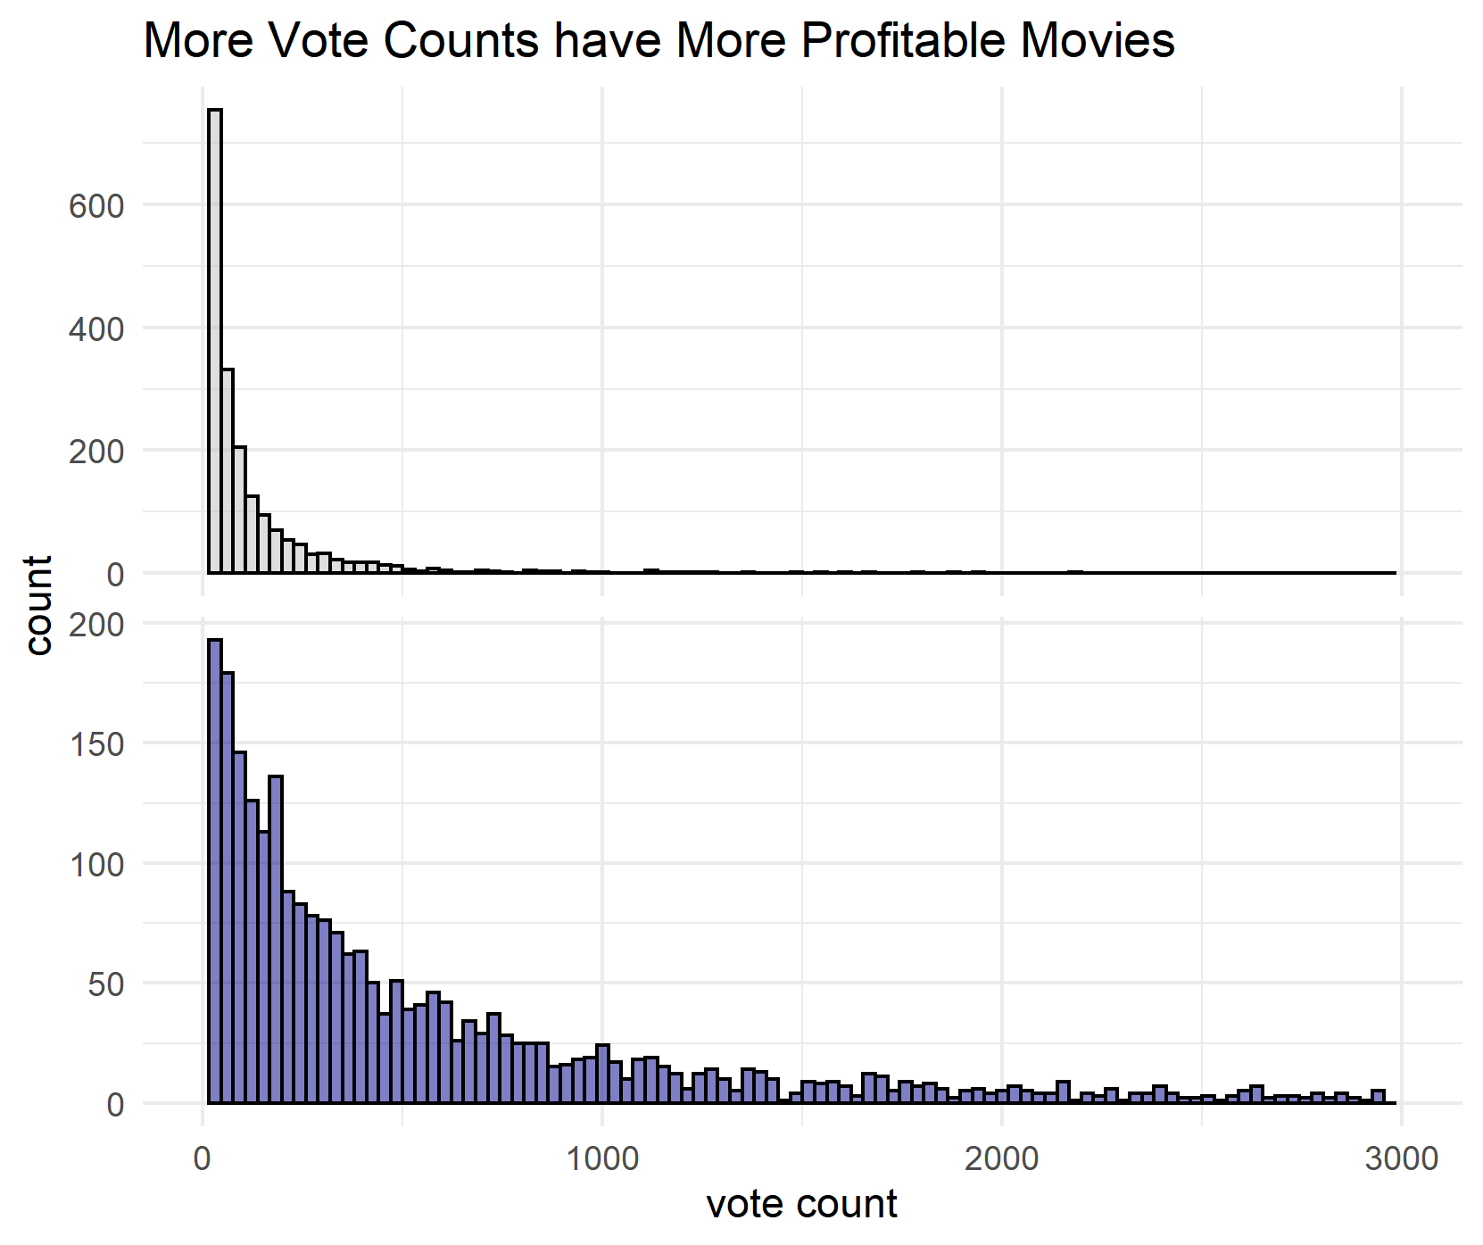
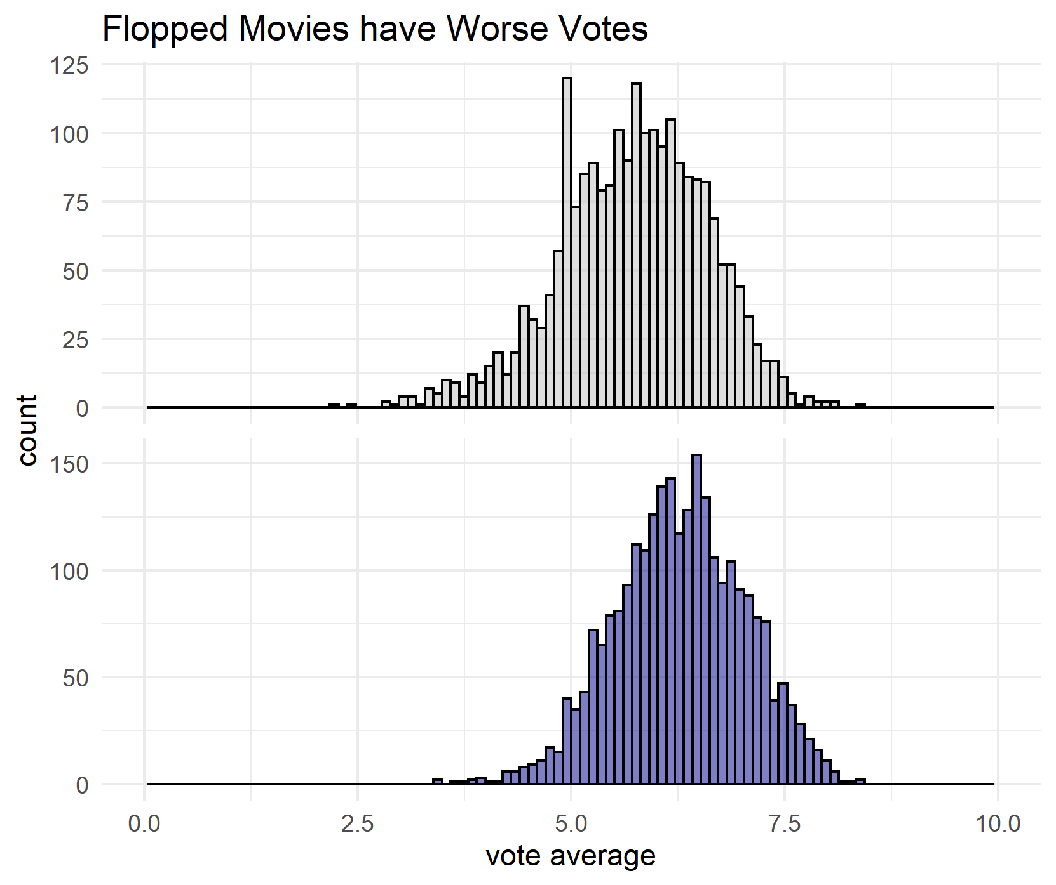
Use Case: How to not flop an expensive movie?
Flopped Movies versus Successful Movies
CONFIDENTIAL © 2020 MDI NOVARE, Inc. All rights reserved.
Notes:
Goal: profiling their customers as to show signs of improvement understanding on the customers paying conduct
To analyse the patterns of paying behavior of the customers
To identify the features or variables of customers on paying electricity
To determine the most suitable data mining model based on identified variables

Slide 7
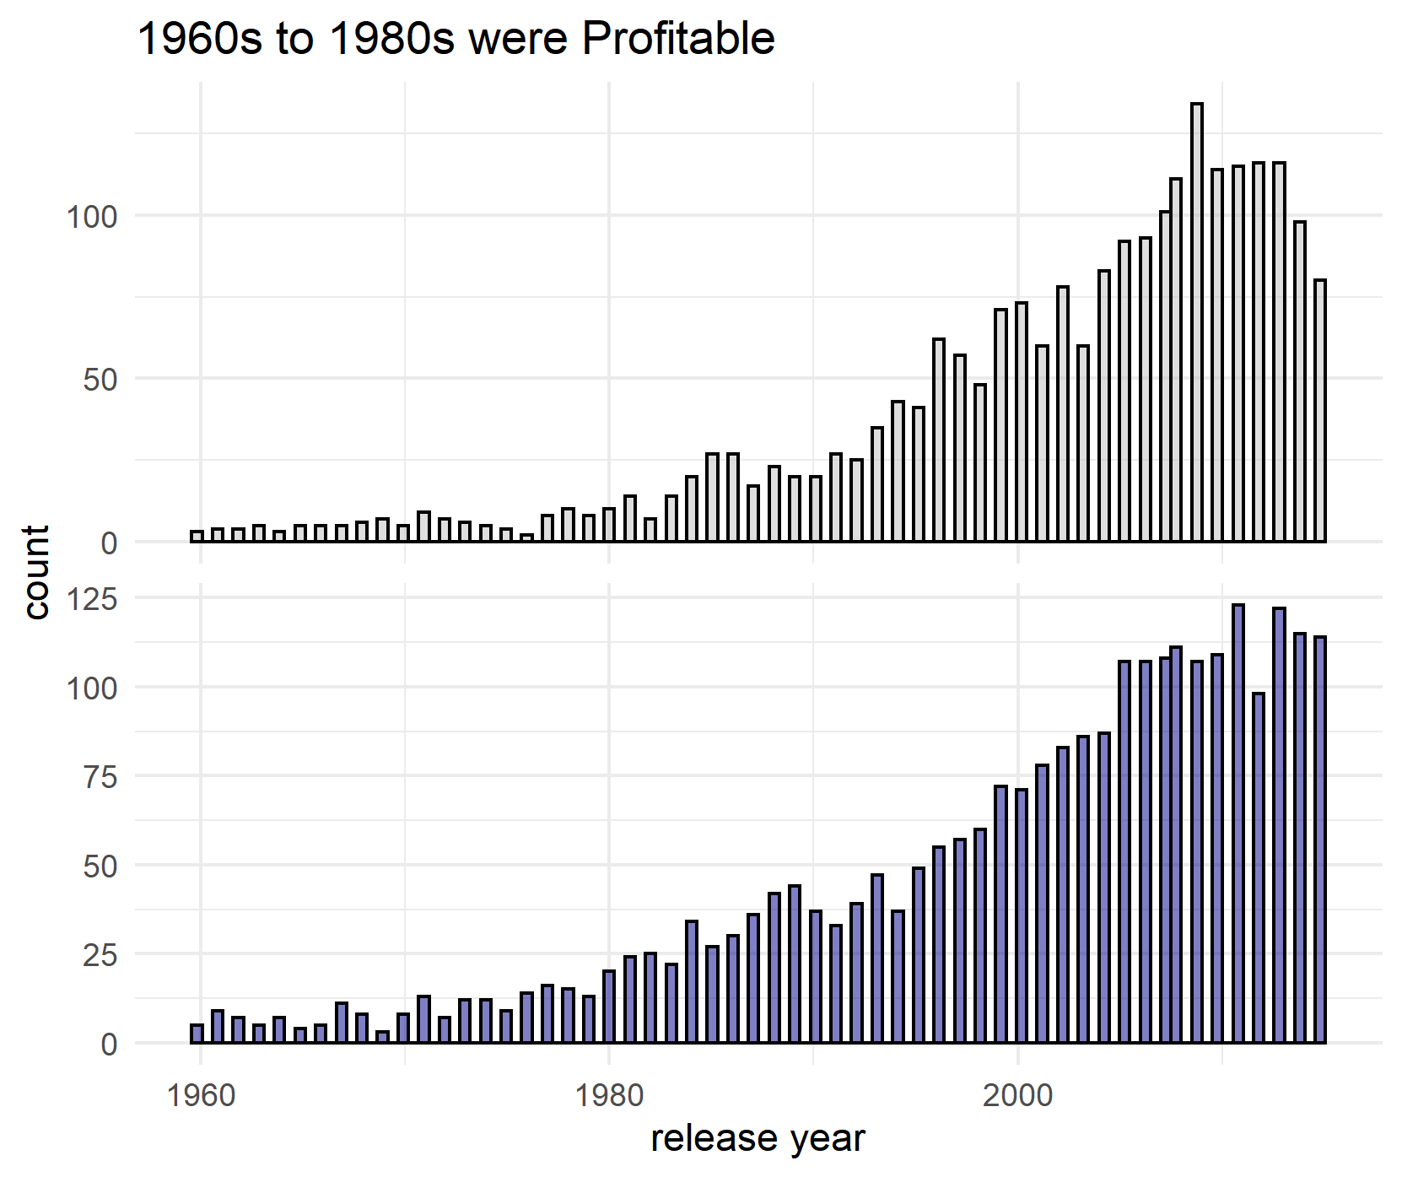
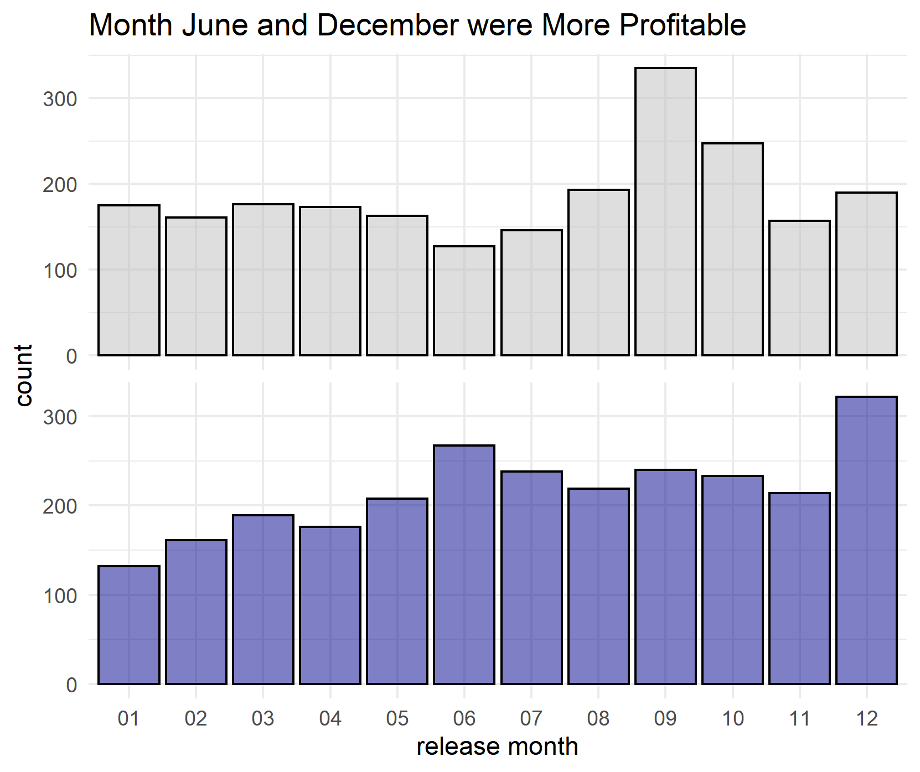
Use Case: How to not flop an expensive movie?
Flopped Movies versus Successful Movies
CONFIDENTIAL © 2020 MDI NOVARE, Inc. All rights reserved.
Notes:
Goal: profiling their customers as to show signs of improvement understanding on the customers paying conduct
To analyse the patterns of paying behavior of the customers
To identify the features or variables of customers on paying electricity
To determine the most suitable data mining model based on identified variables

Slide 8
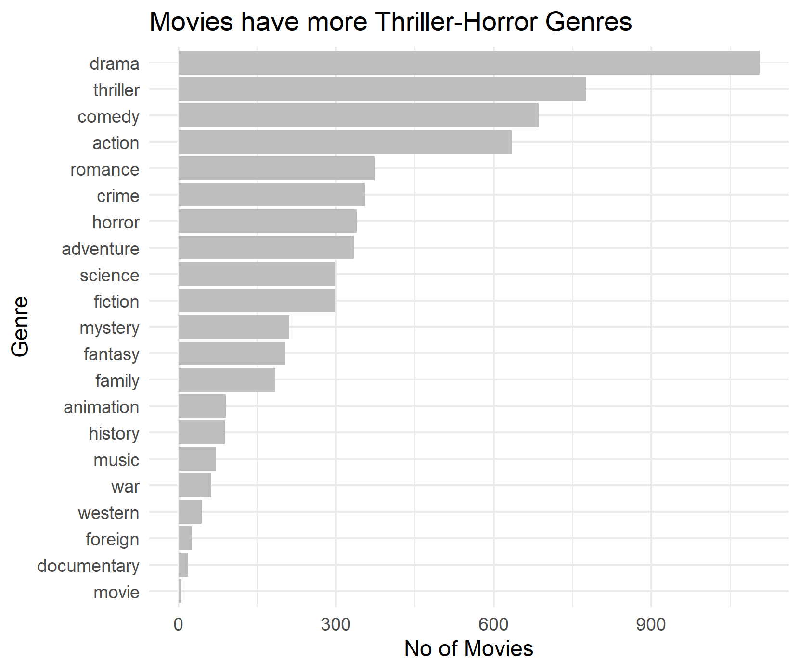
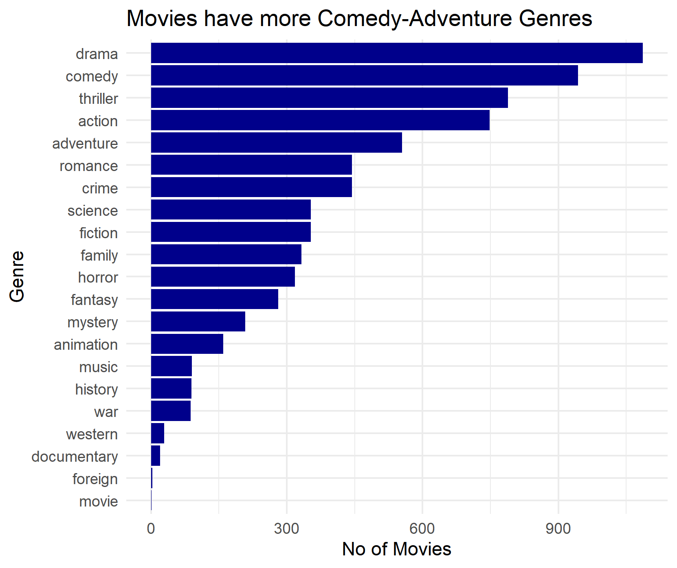
Use Case: How to not flop an expensive movie?
Flopped Movies versus Successful Movies
CONFIDENTIAL © 2020 MDI NOVARE, Inc. All rights reserved.
Notes:
Goal: profiling their customers as to show signs of improvement understanding on the customers paying conduct
To analyse the patterns of paying behavior of the customers
To identify the features or variables of customers on paying electricity
To determine the most suitable data mining model based on identified variables

Slide 9
Use Case: How to not flop an expensive movie?
Summary: What makes a successful expensive movies?
Successful Movies have the following characteristics:
Popularity Score, popular movies are more profitable
Movie Runtimes, runtimes don’t affect profitability
Vote Count, more vote counts implies more profitability
Vote Average, flopped movies have worse votes
Release Year, movies in 1960s to 1980s were more profitable
Release Month, more profitable movies release in June and December
Genre, more profitable movies are in comedy-adventure genre while more flopped movies are in thriller-horror genre
Big movie budget don’t assure success/profitable
CONFIDENTIAL © 2020 MDI NOVARE, Inc. All rights reserved.
Notes:
Goal: profiling their customers as to show signs of improvement understanding on the customers paying conduct
To analyse the patterns of paying behavior of the customers
To identify the features or variables of customers on paying electricity
To determine the most suitable data mining model based on identified variables

